Slide 1

Facial Occlusion Detection and Classification in Controlled Laboratory Environments
Presented by
Varshan Durai M K
Abishekamoorthy R
Yashvardhan Sujish Kumar
Guided by
Ms. Anitha V P

Slide 2
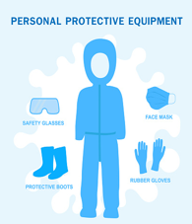
ABSTRACT
OpenCV captures video frames, and YuNet detects faces in the laboratory environment. A Convolutional Neural Network (CNN) classifies each detected face into three categories: Fully Visible, Safety PPE Compliant, and Unauthorized Occlusion.
The system analyzes facial key points and covered regions around the eyes, nose, and mouth to identify masks and protective eyewear. It compares the detected facial conditions with predefined laboratory safety rules to determine PPE compliance.
The system supports alerts when unauthorized occlusion or PPE non-compliance is detected. It also records timestamps, predicted classes, and image snapshots for future review. The system's accuracy and processing speed will be evaluated using a separate test dataset.

Slide 3

PROBLEM STATEMENTS
1. Manual Safety Monitoring: Manual monitoring of laboratory personnel is time-consuming and makes continuous safety compliance difficult.
2. Facial Occlusion Detection: Objects such as masks, scarves, hands, and other coverings can obstruct facial visibility, making automated monitoring challenging.
3. PPE Compliance Verification: Existing face detection systems may detect a face without verifying whether the person is wearing the required combination of a face mask and safety goggles.
4. Classification of Facial Conditions: A system is needed to distinguish between fully visible faces, faces wearing the required PPE, and faces with improper or unauthorized occlusions.
5. Real-Time Monitoring: Continuous monitoring requires a system that can process live webcam or CCTV video and provide classification results with minimal delay.
6. Automated Alerts and Logging: Manual identification and recording of safety violations can delay corrective action. An automated mechanism can help flag and record potential violations.

Slide 4
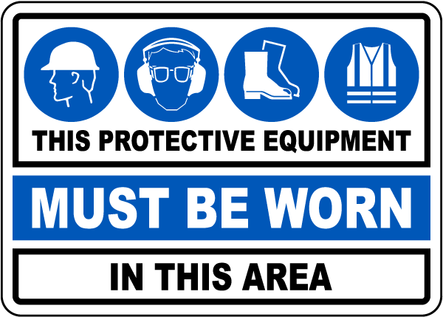
OBJECTIVES
To detect human faces in real time using YuNet.
To classify facial conditions into three predefined categories using ResNet18.
To identify the presence of required mask and safety goggles together.
To display classification results and confidence scores on live video.
To support laboratory safety monitoring through automated visual assessment.

Slide 5
LITERATURE SURVEY
S.NO | PAPER TITLE | AUTHOR | PROBLEM CONCERNED | CONCEPT | LIMITATIONS
1 | Head Pose Estimation (2022) | Rahmaniar et al. | Detecting faces with different poses and occlusions | CNN-based method | Limited details on real-time performance
2 | Face Mask Detector (2021) | Putro et al. | Detecting masked and unmasked faces | Lightweight CNN | Focuses mainly on mask detection
3 | Occlusion Robust Face Recognition (2019) | Song et al. | Face recognition when facial parts are occluded | Siamese Network | Recognition may be affected by severe occlusion
4 | Face Occlusion Detection (2015) | Xia et al. | Detecting different types of facial occlusion | Multi-task CNN | May not cover all modern PPE types

Slide 6
RESEARCH GAP
Existing System Lack:
Manual monitoring requires continuous human supervision.
Face detection alone cannot determine whether required PPE is being worn correctly.
Many systems focus on a single task, such as face-mask detection or general face detection.
Facial occlusions can make visual classification more challenging.
A unified real-time classification approach for laboratory PPE assessment may be lacking in the selected systems.
Our Approach:
Uses YuNet to detect faces from live webcam video.
Uses a ResNet18 deep learning model to classify detected face regions.
Classifies each detected face into three categories: Fully Visible, PPE Compliant, and Unauthorized Occlusion.
Checks for the required combination of a mask and safety goggles.
Displays the predicted class and confidence score for real-time visual monitoring.

Slide 7

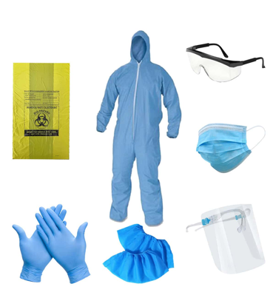

PROPOSED SYSTEM
Face Detection – Detects and extracts the face region from a live webcam or IP-camera stream.
Occlusion Isolation – Identifies covered regions around the eyes, nose, and mouth using facial key points.
PPE Classification – Detects PPE such as masks, respirators, safety goggles, and face shields.
Safety Verification – Checks whether the detected PPE satisfies the required laboratory safety rules.
Real-Time Alert – Generates an alert when an unauthorized occlusion or PPE violation is detected.
Automated Logging – Stores violation timestamps and snapshots for security monitoring.

Slide 8
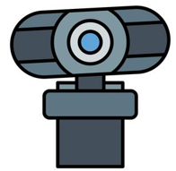

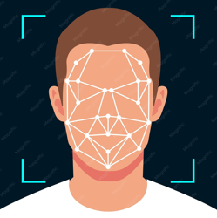
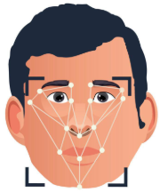
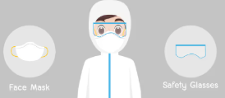

SYSTEM ARCHITECTURE
INPUT SOURCES
VIDEO FRAME ACQUISITION
FACE DETECTION
FACE REGION EXTRACTION & PREPROCESSING
The laptop webcam is used initially. Later, your system can receive a laboratory IP-camera/CCTV stream
OpenCV continuously captures individual frames from the video.
YuNet detects the person's face and creates a bounding box around it.
The detected face is cropped from the frame and resized to
OUTPUTS
DECISION & ALERT MODULE
CNN CLASSIFICATION
The prediction is compared with your laboratory safety rules.
The CNN learns visual patterns from your training images and predicts one of the three classes:
If an unauthorized condition is detected, the system can:
Display an alert on screen
Record the event
Store date/time
Store the prediction
Later send a notification
- Fully Visible
FULLY VISIBLE
- PPE Compliant
PPE COMPLIANT
- Unauthorized Occlusion
UNAUTHORISED OCCLUSION

Slide 9



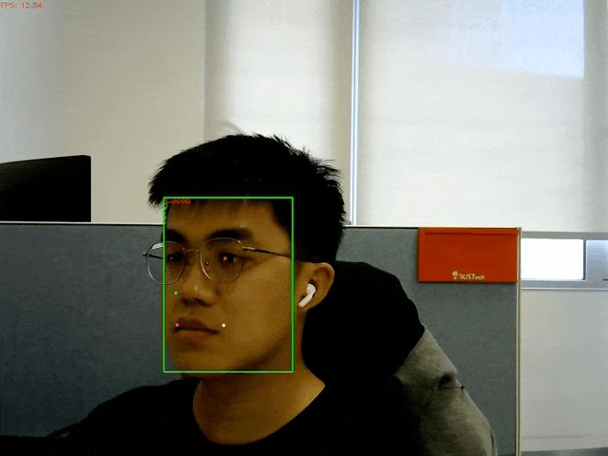
TECHNOLOGY USED
1. Python
Used to implement the face detection, deep learning classification, and real-time monitoring pipeline.
2. OpenCV
Captures webcam video, processes frames, detects faces through YuNet, and displays classification results.
3. PyTorch
Loads and runs the trained ResNet18 model to classify facial images.
4. ResNet18
Classifies detected face regions into Fully Visible, PPE Compliant, and Unauthorized Occlusion.
5. YuNet
Detects faces in live video before they are passed to the classification model.

Slide 10
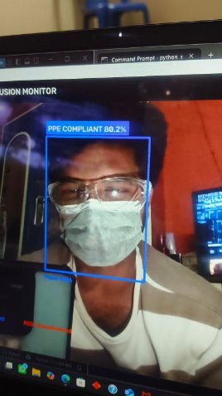
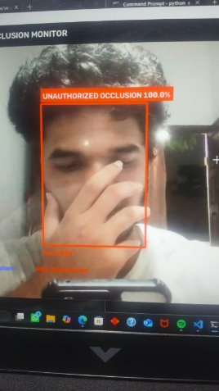
IMPLEMENTATION
This is fully compliant, it shows whether the person is wearing the safety goggles and mask
FILES USED FOR IMPLEMENTING:-
build_final_dataset.py
cnn_model.py
dataset_loader.py
evaluate_model.py
face_ppe.py
filter_ppe.py
laboratory_cctv.py
mask_detection_cctv.py
prepare_unauthorized.py
review_unauthorized.py
sort_occlusion.py
split_fully_visible.py
split_ppe_dataset.py
train_mask_model.py
train_model.py
verify_fully_visible.py
verify_ppe_dataset.py
verify_unauthorized.py
webcam_demo.py
This is unauthorized occlusion, it shows when the face is covered, but not with a mask. This will be registered as unauthorized occlusion.

Slide 11
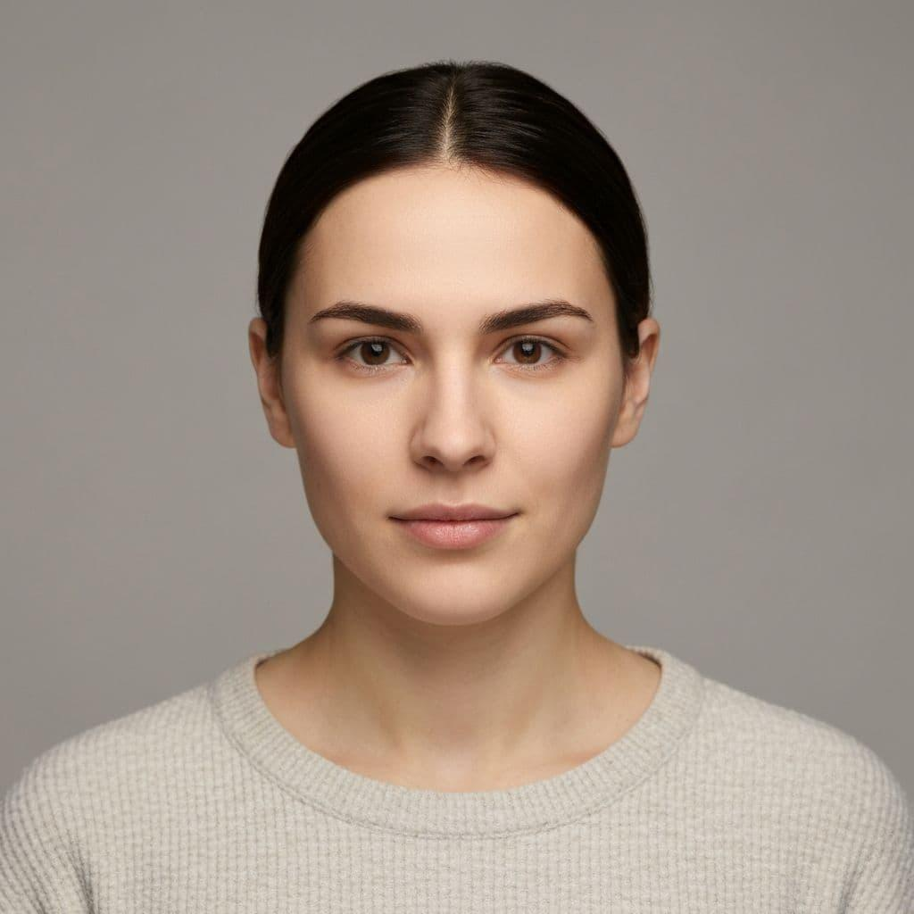
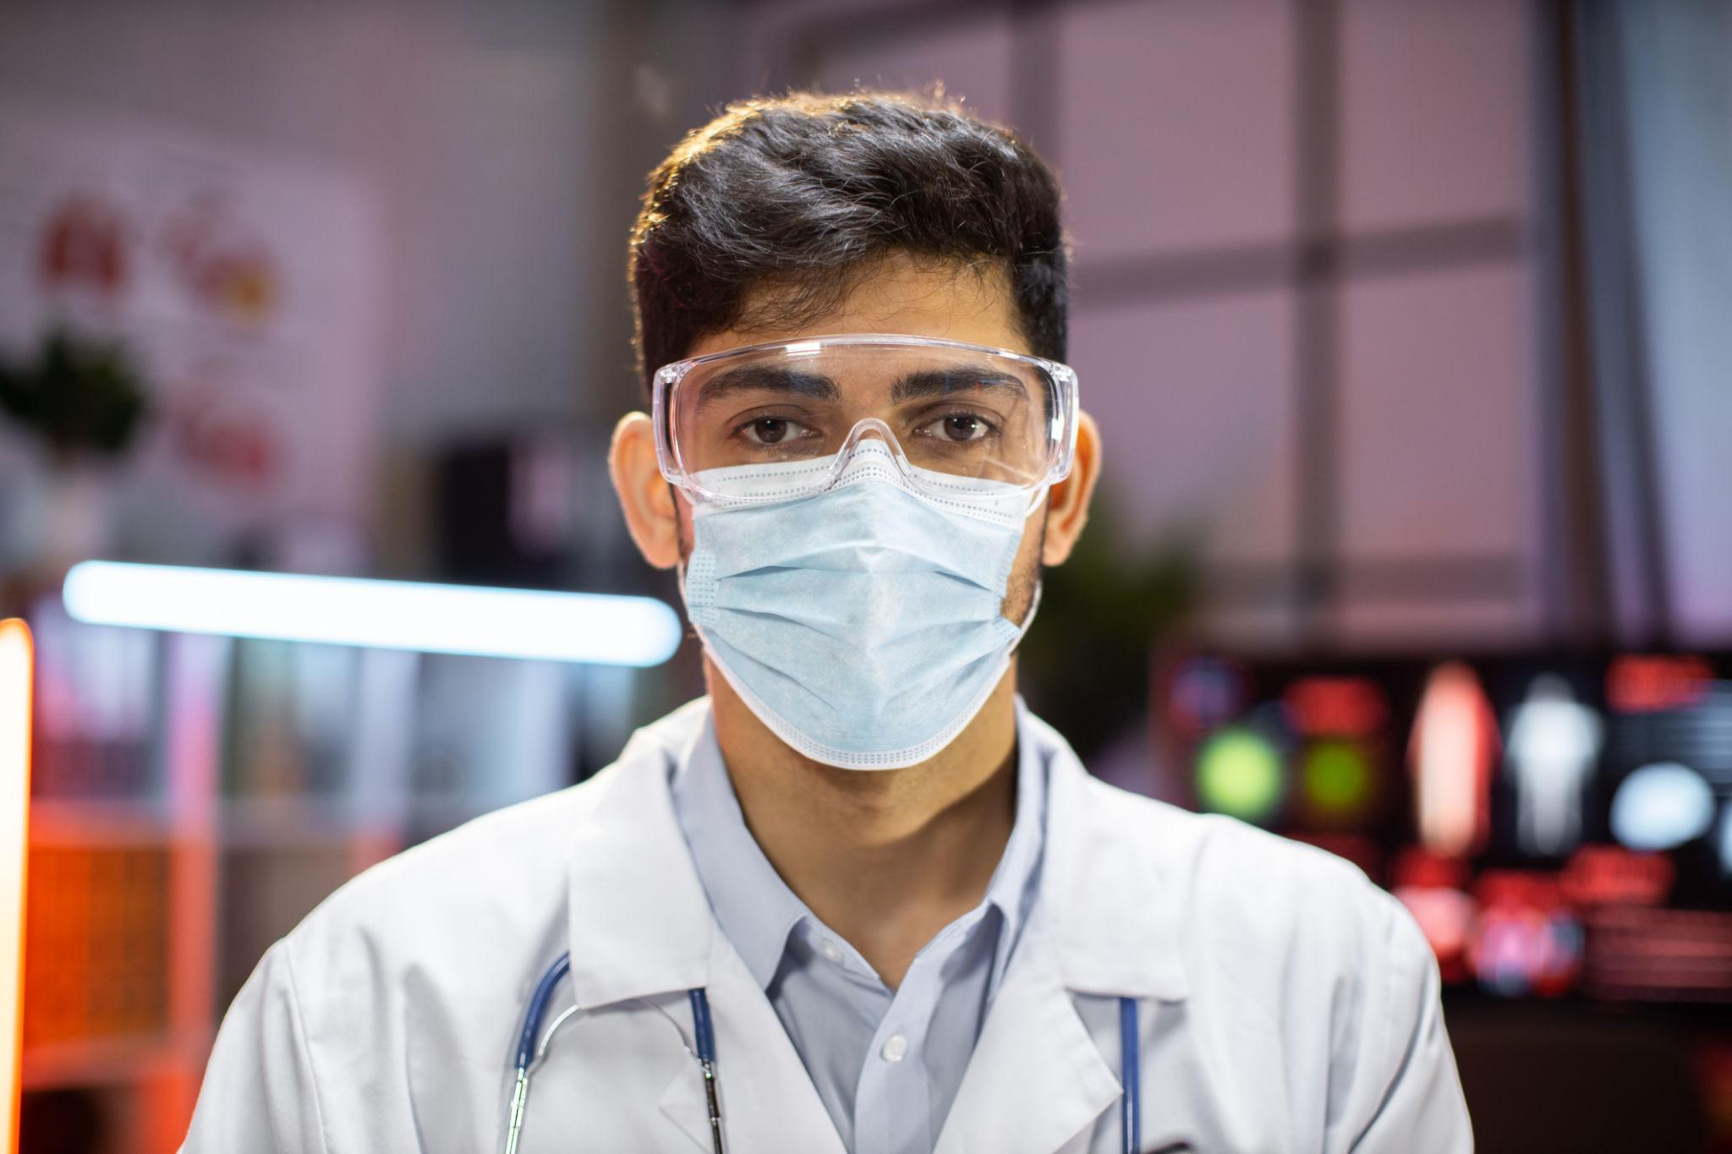
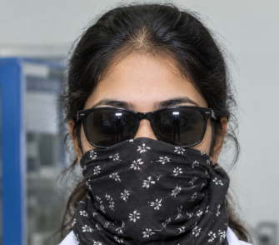
DATA SETS
FOR TRAINING:
1,000–2,000 images per class
Total: 3,000–6,000
images Split: 70% training / 15% validation / 15%
Fully Visible: Normal uncovered face
Safety PPE Compliant: Face with approved mask, respirator, goggles, face shield
Unauthorized Occlusion: Face deliberately covered, hoodie/cloth covering, improper PPE
testing Include different lighting, face angles, distances, skin tones, and degrees of occlusion.

Slide 12
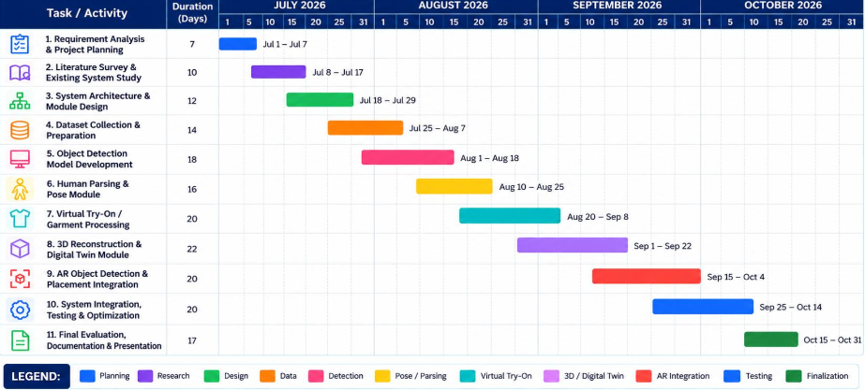
GANTT CHART:

Slide 13
CONCLUSION:
FUTURE SCOPE:
Developed a real-time facial occlusion detection and classification system using YuNet, CNN (ResNet18), and OpenCV.
Classifies faces into three categories: Fully Visible, PPE Compliant, and Unauthorized Occlusion.
Displays predicted classes and confidence scores to support laboratory safety monitoring.
Provides a foundation for automated PPE compliance assessment in laboratory environments.
Improve Accuracy: Train with larger and more diverse datasets.
Advanced Detection: Improve performance under poor lighting, different angles, and partial occlusion.
Automated Alerts: Generate alerts when potential PPE non-compliance is detected.
Event Logging: Store detection results with timestamps for later review.
CCTV Integration: Extend the system to support multiple surveillance cameras.
Model Optimization: Reduce processing time for faster real-time performance.

Slide 14
REFERNCES
Rahmaniar et al. – Head Pose Estimation
CNN-based approach for handling different head poses and partially covered faces. (2022).
Putro et al. – Face Mask Detector
Lightweight CNN approach for real-time face-mask detection. (2021).
Song et al. – Occlusion Robust Face Recognition
Siamese Network approach for improving face recognition under facial occlusion. (2019).
Xia et al. – Face Occlusion Detection
Multi-task CNN approach for detecting occluded facial regions. (2015).

Slide 15
THANK YOU!

